Slide 1
Application frameworks
JavaScript, Version controlling and NoSQL

Slide 2

Overview
JavaScript
Version controlling
NoSQL

Slide 3
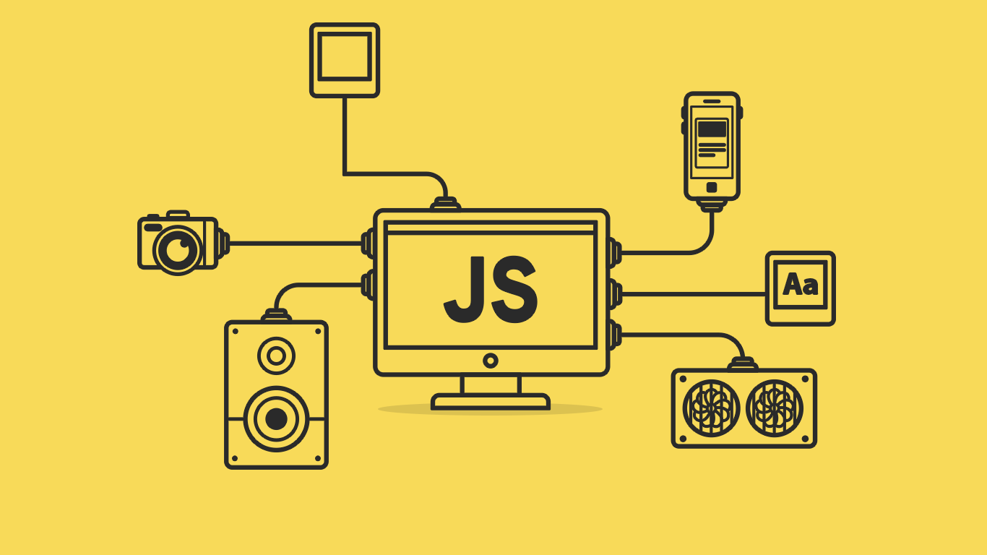
JavaScript
Introduction
Classes, objects and prototype
How ‘this’ acts
Strict notation
Function closure
Callbacks and promises

Slide 4
JavaScript
By default, JavaScript programs run using a single thread. Though there are ways to create new threads JavaScript is considered as Single threaded language.
JavaScript does not wait for I/O operations to get completed, instead it continues the execution of the program. This is called as non-blocking I/O.
JavaScript is asynchronous because of the NIO nature.
JavaScript is dynamically typed. It determines variable types, ordering etc. in runtime.
JavaScript support OOP as well as functional programming (Multi-paradigm).
JavaScript has an eventing system which manages it’s asynchronous operations.

Slide 5
Classes and objects
In JavaScript, a constructor function is used with the ‘new’ key keyword when creating a Object.
Constructor function is a just another function.
When function is used with ‘new’ keyword that function acts as a Class.
Recently JavaScript introduced ‘class’ keyword, but it is not yet adopted by all JavaScript engines.
Another way of creating a object is using object literals (‘{}’). These objects are considered to be singleton.
JavaScript supports static methods and variables.
When ‘new’ keyword is used, new object is created and it assigned as ‘this’ for the duration of call to the constructor function.

Slide 6
Prototypes
JavaScript functions has a reference to another object called prototype. It is somewhat similar to class definition in other languages.
It is really another object instance.
In JavaScript prototype object is used when creating objects, for inheritance and adding methods to a JavaScript class.
Because of the flexibility in JavaScript there are multiple ways to create classes as well as to extend classes. Prototypes are the recommended way of doing so.
Function that is being used to create objects is called a constructor function.
Object instance also has a prototype it is basically the object instance from which object is being created. Object ‘__proto__’ is where object get its properties inherited from.
Functions prototype is used to inherit properties to object instances.

Slide 7
‘this’ in JavaScript
Unlikely other languages in JavaScript ‘this’ keyword acts differently.
Inside a object ‘this’ refers to object itself.
In global context ‘this’ refers to global object (in browser it is the window object). This behaviour will get changed in strict mode.
If a function which is using ‘this’ keyword is being passed to another object then ‘this’ will refers to that object, but not to the original object where function was declared at first place.
This behaviour is very noticeable in callback and closures.

Slide 8
Strict notation
Restricted mode of JavaScript.
Purpose it make it easier to write secure JavaScript.
Strict mode make bad practices in JavaScript to errors.
Keep developer away from using syntaxes that will get invalidate with future JavaScript developments.
For example it does not allows to create variables without the var keyword (Variable have to be declared).
Another example would be it will stop referring to the window object as ‘this’ from outside object instances.

Slide 9
Closure
JavaScript closure is a function which returns another function.
In JavaScript closure is used to encapsulate variables into a function and restrict access to it from the outside.
JavaScript creates an environment with all the local variables from the outer function when the inner function is created. Closure is the combination of this environment and the inner function.

Slide 10
Callback and promises
JavaScript is asynchronous. All I/O operations in JavaScript is implemented to be asynchronous by nature.
Reason for this is JavaScript being a single threaded language if an I/O operations holds the thread till it get completed JavaScript won’t perform well as a programming language.
But asynchronous operation introduce difficulty when we need to do synchronous processing using data.
This is solved by using callbacks and promises.
Callback is a function that is being passed to an async task and on completion the function will be executed.
Promise is an object that is being returned from async tasks. Promise have properties to deal with async operations synchronously.

Slide 11
Callback and promises…
Nested callbacks passed into sequence of async tasks is referred to a ‘callback hell’.
Promise object was introduced to solve this problem.
Promise object has a set of properties, methods and mechanism of chaining to handle complex async tasks nicely.

Slide 12

Version controlling
What and why?
Terminology
Best practices
GIT

Slide 13
What?
Managing changes to a source.
Changes are identified using a revision number.
Each revision has its timestamp as well as the person who done the change.
Revisions can be restored, compared and merged.
“Management of multiple revisions of the same unit of information”

Slide 14
Why?
Easier backups and centralized source code repository.
Easy collaborative development.
Overview of changes performed to a file.
Access control.
Conflict resolvement.

Slide 15
Terminology
Repository
Central location where all the files are being kept. Usually a directory with set of files.
Trunk
Also referred to as master branch. This is where the most stable code is being placed which is referred as the production code.
Stage
Mark files for tracking changes.
Commit
Create a snapshot of the changes being made to the files.

Slide 16
Terminology…
Branch
Copy of the master branch taken at a given point. All the feature developments and bug fixes will be done in a branch. Usually it is allowed to have multiple branches at the same time.
Checkout
Mark/unlock file for changing.
Merge
Combining branches together to update the master branch.
Merge conflict
Merge conflicts occur when merging a file which has been changed in two separate branches or places. Changes that interfere other changes.

Slide 17
Best practices
Use a source control system.
Always make sure to have the latest version of the file.
In distributed source control system advice is to get the latest source code at least start of the day.
Checkout only what you need.
Merge code with the development branch at least once per day.
Always make sure code is working as expected and it is not causing any other code to break.
Follow a formal review process when merging.

Slide 18
Git
Most popular version control system.
Distributed version control system.
Client get a complete clone of the source code. In a disaster situation full source along with all history can be restored from a client.
Free and open source.
Multiple branches and tags.
Feature branches, role branches (production).
Faster comparing to other systems (works on a linux kernel and written in C).
Support multiple protocols
HTTP, SSH
Staging area, local commits and stashing.
Staging area - Mark files to be committed.
Local commit - Commit code locally without pushing into the remote branch.
Stashing - Keep file changes in Stash and apply them in a later.

Slide 19
Git commands
Git init
Git clone
Git add
Git stage
Git commit
Git push
https://confluence.atlassian.com/bitbucketserver/basic-git-commands-776639767.html

Slide 20
Git: Interactive Learning
Following are two good interactive demos for learning git.
The fundamentals are found in [1] and advanced branching demo is in [2].
[1] https://try.github.io
[2] http://pcottle.github.io/learnGitBranching/
Notes:
The [1] contains the basics (basic commands init, pull, add, commit, push) and the [2] contains intermediate to bit of advanced level where most of advanced features are discussed. (ex: cherrypick, revert, branching models and how to use branches and move commits around)

Slide 21
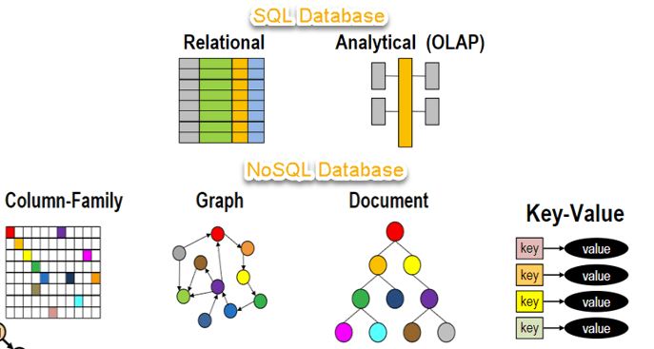
NoSQL
What?
Why not SQL?
Strengths and weaknesses
MongoDB

Slide 22
What?
Non relational (mostly), Schema free.
Distributed.
Horizontally scalable.
Easy replication.
Eventually consistent.
Open source (mostly).
No transaction support.

Slide 23
Why?
Remove the burden of data structures mismatch between application in-memory and relational databases.
Integrate databases using services. (ElasticSearch).
Relational databases not designed to run efficiently on clusters.
Aggregate oriented databases, are easier to manage inside clusters and based on the domain driven design. (Order details inside the order).
But inter aggregate relationships are harder to manage.

Slide 24
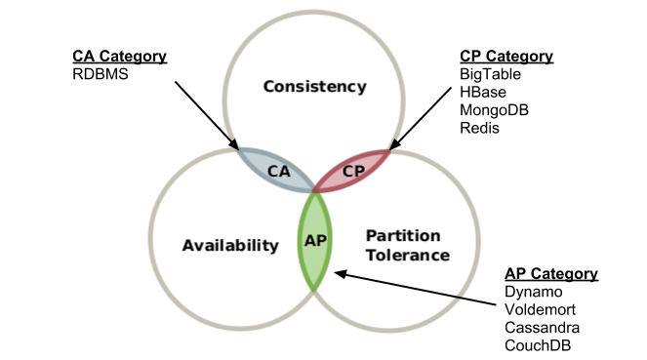
CAP theorem
Consistency - Every read receives the most recent write.
Availability - Every request receives a response (no guarantee that it is the most recent write).
Partition tolerance - System will continue to operate despite number of messages lost among network nodes.

Slide 25
Types
Key-Value - Stores data as key value pairs.
Ex: Redis, Riak, Memcached.
Document - Stores data as documents (JSON, BSON, XML) in maps or collections.
Ex: MongoDB
Column Family - Store data in column families as rows that have many columns associated with.
Ex: Cassandra
Graph - Store entities(nodes) and relationships(edges) between them and represent it in a graph.
Ex: Neo4j

Slide 26
MongoDB
NoSQL document database.
Strong query capabilities with aggregations using JavaScript.
Use SpiderMonkey JavaScript engine.
High availability with replica sets.
Reads and writes on primary by default.
Eventually consistent on secondary instances.
In built file storage called Grid File System.

Slide 27
MongoDB queries
Insert
Find
Update
Remove

Slide 28


